Slide 1
CS3210 Lab 1
Processes, Threads, and Synchronization Basics
Slides inspired by Sriram's slides
Notes:
Prep:
http://172.26.191.239:8888/
Connect to soctfs
./sem

Slide 2
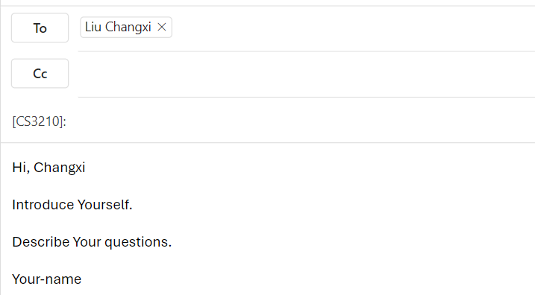
About myself
Liu Changxi
Y4 PhD student
Mainly working on CPU/GPU architecture exploration and simulation.
Questions
Email me at changxi_liu@u.nus.edu

Slide 3
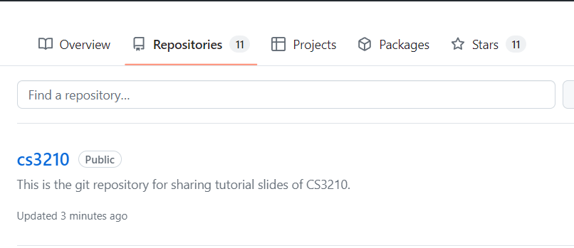
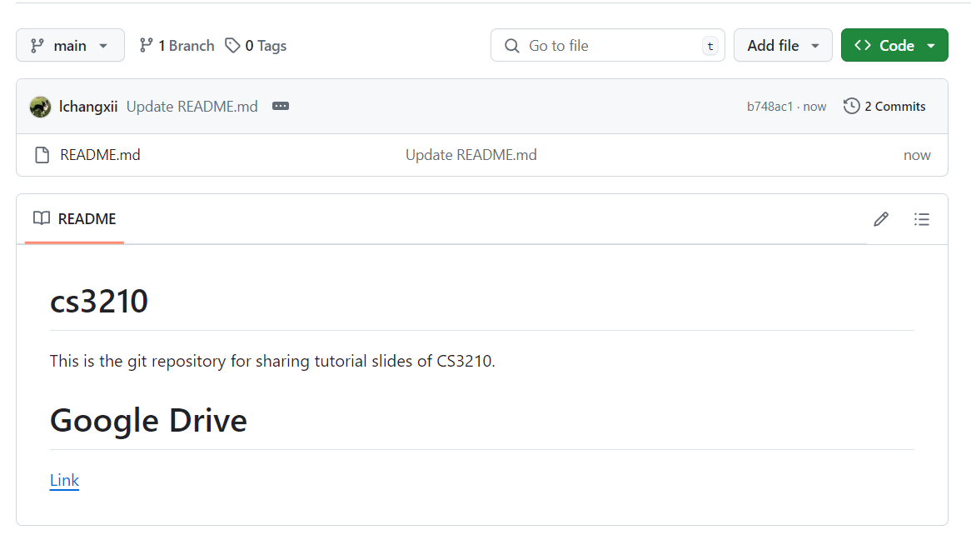
Questions and Slides Sharing
All these will be shown again at the end~
Slides
Github and Google Drive after every session.
https://github.com/lchangxii/cs3210
You can find the Link in the README if preferring Google Drive

Slide 4
Raw Power: Three Pillars of CS3210
Part 1: OpenMP
Making single-node CPU programs faster
Complex tasks that are relatively less parallelizable (10s of tasks)
Part 2: CUDA
Making single-node GPU-able programs faster
Simpler tasks that are relatively more parallelizable (millions of tasks even)
Part 3: MPI
Making multi-node programs faster
Large, mixed workloads (slow communication between nodes is worth it due to size / parallelizabilty of work)
The complexity: how to harness this power effectively?

Slide 5
Why Parallel Computing?
Simply put: Make things go fast.

Slide 6
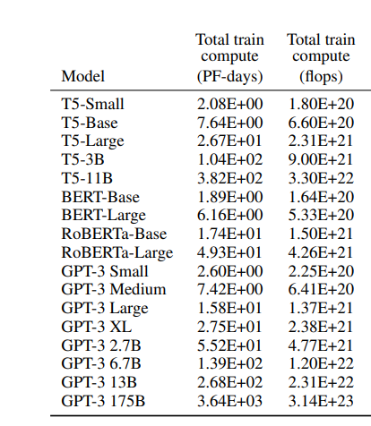
Why Parallel Computing?
Simply put: Make things go fast.
For example:
Training full-size GPT-3: 3.14xe²³ Flops with 1000 H100 GPUs (51.22 TFLOPS)
In theory, 70 days are required (ignore communication overhead, etc.)
Source: [1]
[1]. Brown, T. B. et.al. Language models are few-shot learners. NeurIPS 2023

Slide 7
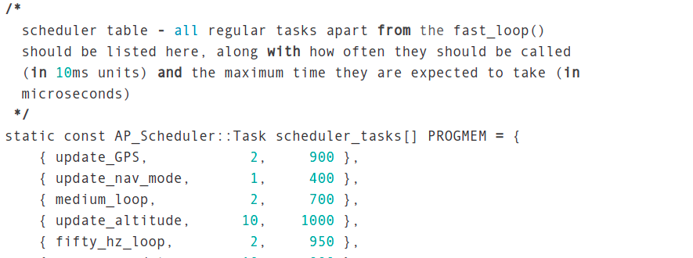
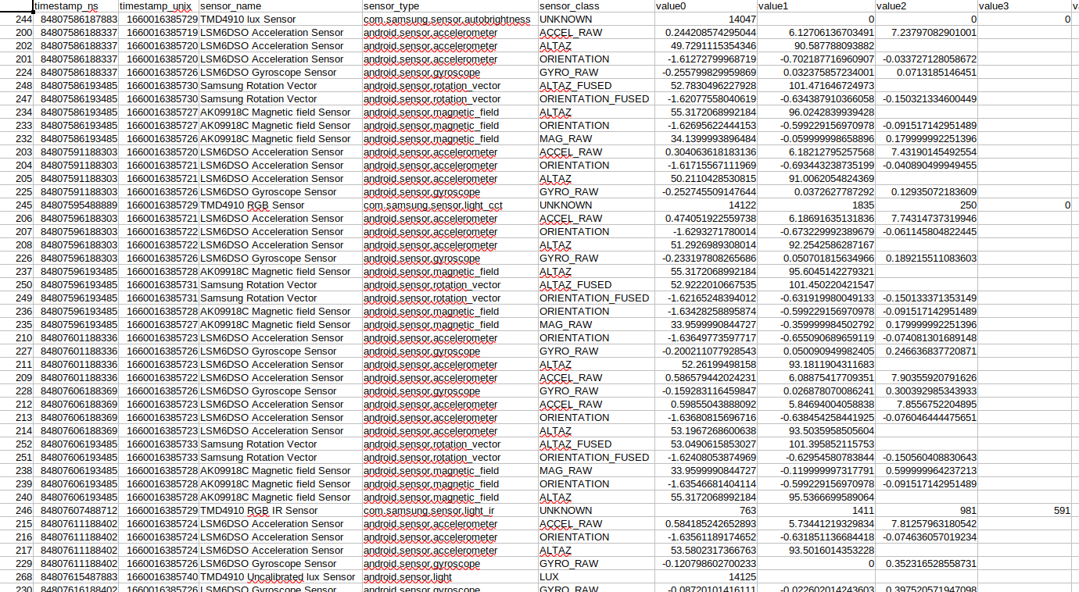
Our goals
Learn how to decompose problems into tasks
Task parallelism
Data parallelism
Images taken from Sriram's slides

Slide 8
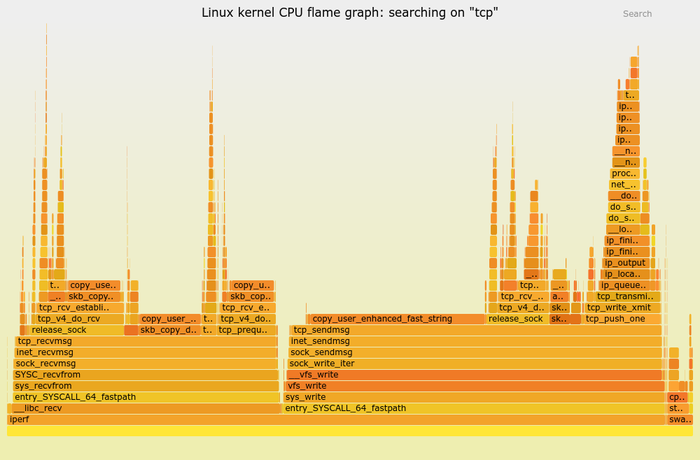
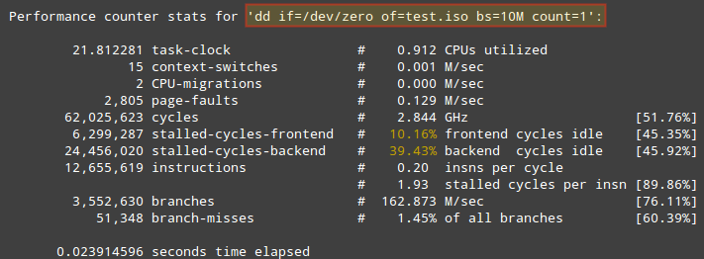
Our goals
Become systems detectives: think holistically about performance
Is it the algorithm? Disk? Cache? Network? Not enough work? Too much work? Synchronization overhead? Theory alone is useless here.
Images taken from Sriram's slides

Slide 9
Our goals
Have fun!
Very satisfying to make a program faster. You will hopefully understand soon :)
GIFs taken from Sriram's slides

Slide 10
General Lab Workflow
For you
Labs/Tutorials are for you to learn. No stress. Only a small percentage of grade. Please experiment!
Please feel free to talk, communicate.
Me
I will try not to give direct answers, but I will guide
I might be hovering to help

Slide 11
Today’s lab: Processes/Threads/Synchro

Slide 12
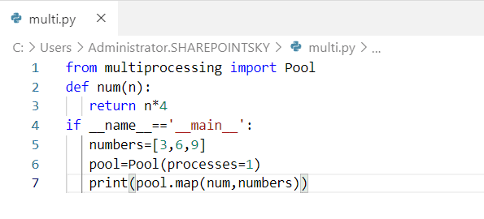
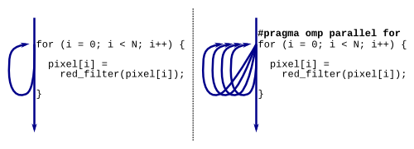
Why teach synchronization first?
Because anyone can solve embarrassingly parallel problems.
Python
C/C++

Slide 13
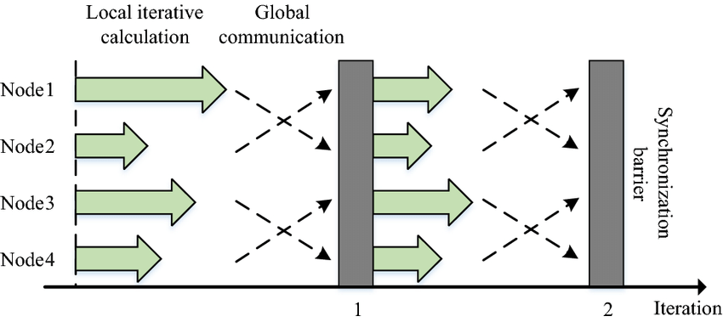
Why teach synchronization first?
The difficult part is coordinating between tasks - synchronization!

Slide 14
Lab 1 - Tasks
Connect to lab machines, download code
ex1: processes with fork/wait
ex2: pthreads ordering, counter variable
Semaphore usage
ex3: race condition
ex4: pthread joining
ex5: pthread mutexes
ex6: condition variables (starts to get challenging)
ex7: producer-consumer: pthreads (for submission)
ex8: producer-consumer: processes and semaphores (for submission)
ex9: Explanation of observations of ex7 & ex8 (for submission)

Slide 15
Connecting to lab machines
https://bit.ly/cs3210-lab-connection-guide
ssh into soctf-pdc-xxx.d1.comp.nus.edu.sg (where xxx is 002-003 or 009-011, pdc-001 is down for now.) for example: ssh soctf-pdc-002.d1.comp.nus.edu.sg
If you are outside of the SoC network, log into SoC VPN at first.
Terminal to use: VSCode, git bash, Xshell, terminal (MacOS), PowerShell (Windows)
Credentials should have been emailed to you. You will be asked to change your password on your first login. (Remember the new password)
Download lab code into the machines.
wget https://www.comp.nus.edu.sg/~srirams/cs3210/L1_code.zip
unzip L1_code.zip
For VSCode users, SSH into the node with Bash/PowerShell first to change your password before using VSCode to connect!!

Slide 16
Connection tips: SSH config file
Consider adding a config like this to your ~/.ssh/config file:
(this allows you to do just ssh soctf)
Host soctf
HostName soctf-pdc-002.d1.comp.nus.edu.sg
User your_lab_id
ForwardAgent yes

Slide 17
For the more advanced users…
Use a SSH key (instead of password)
Enter ssh-keygen into your command prompt
Follow the instructions to generate a key
Upload the .pub key at https://pdc.comp.nus.edu.sg/
Use the other file generated (i.e. your secret key) to ssh!
SSH config file w/ key:
Host soctf
Hostname soctf-pdc-009.d1.comp.nus.edu.sg
User [Your user name]
ForwardAgent yes IdentityFile ~/.ssh/id_rsa

Slide 18
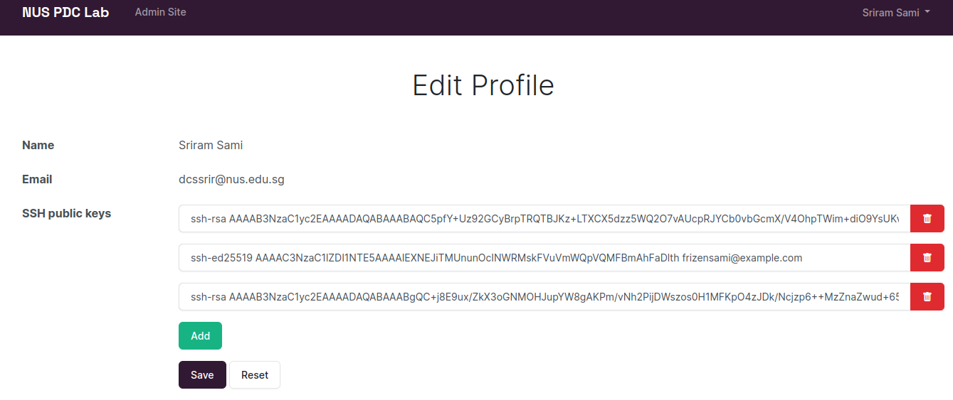
Connection tips: Updating SSH key
https://pdc.comp.nus.edu.sg/accounts/profile/

Slide 19
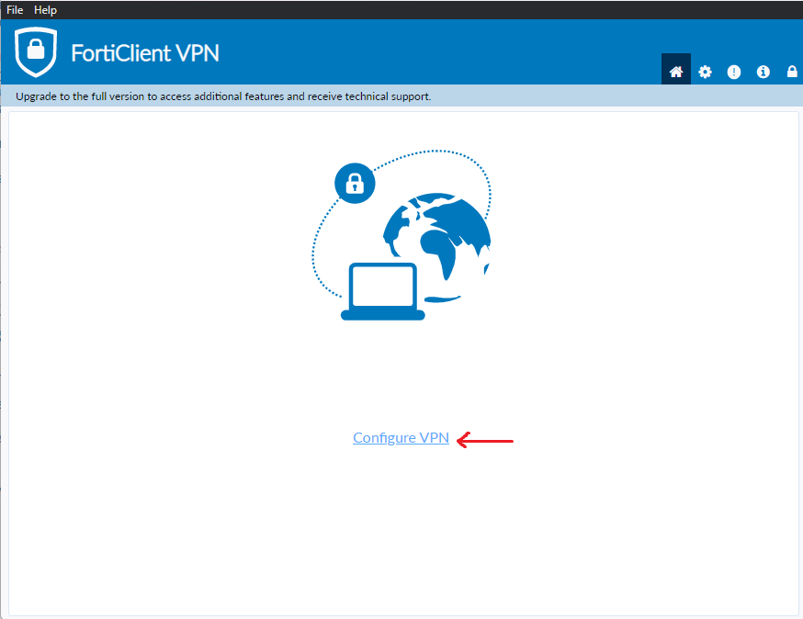
Accessing the machines while not being at SoC…
More important for your assignments, you do not have to do this for this lab.
https://www.fortinet.com/support/product-downloads → Install Forticlient VPN
After installation: Click on Configure VPN
Further reference: https://dochub.comp.nus.edu.sg/cf/guides/network/vpn

Slide 20
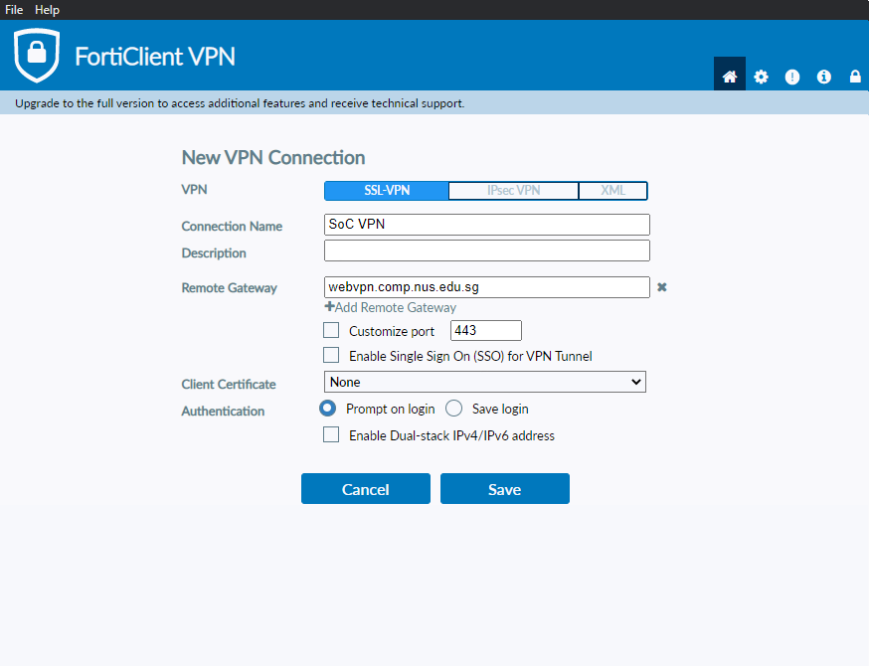
Forticlient VPN Configuration
Ensure VPN is SSL-VPN
Connection Name: SoC VPN
Remote Gateway: webvpn.comp.nus.edu.sg
Authentication can be either one.

Slide 21
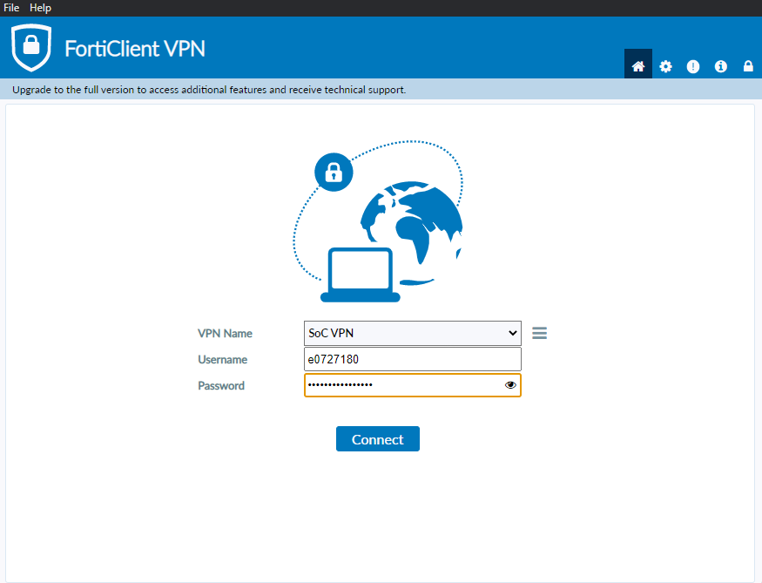
Logging into the VPN
Use your NUS Credentials to login!

Slide 22
Lab 1 - Tasks
Connect to lab machines, download code
ex1: processes with fork/wait
ex2: pthreads ordering, counter variable
Semaphore usage
ex3: race condition
ex4: pthread joining
ex5: pthread mutexes
ex6: condition variables (starts to get challenging)
ex7: producer-consumer: pthreads (for submission)
ex8: producer-consumer: processes and semaphores (for submission)
ex9: Explanation of observations of ex7 & ex8 (for submission)

Slide 23
Lab 1 - Tasks
Connect to lab machines, download code
ex1: processes with fork/wait
ex2: pthreads ordering, counter variable
Semaphore usage
ex3: race condition
ex4: pthread joining
ex5: pthread mutexes
ex6: condition variables (starts to get challenging)
ex7: producer-consumer: pthreads (for submission)
ex8: producer-consumer: processes and semaphores (for submission)
ex9: Explanation of observations of ex7 & ex8 (for submission)

Slide 24
Named vs Unnamed Semaphores semaph_named.cpp (Part 2 in lab1)

Slide 25
Named vs unnamed semaphores
Named semaphores (created with sem_open) are “automatically shared between processes” - how?
Parent process executes:
sem_t* sem = sem_open("pSem", O_CREAT | O_EXCL, 0644, value);
O_CREAT | O_EXCL ⇒ Must create file, else error
Octal 0644 ⇒ rw-r--r-- (Owner read/write, rest read)
So shouldn’t the semaphore be private to each process?
Notes:
https://stackoverflow.com/questions/21129845/why-does-sem-open-work-with-fork-without-shared-memory
https://stackoverflow.com/questions/32205396/share-posix-semaphore-among-multiple-processes

Slide 26
Named vs unnamed semaphores
Named semaphores (created with sem_open) are “automatically shared between processes” - how?
Parent process executes:
sem_t* sem = sem_open("pSem", O_CREAT | O_EXCL, 0644, value);
O_CREAT | O_EXCL ⇒ Must create file, else error
Octal 0644 ⇒ rw-r--r-- (Owner read/write, rest read)
So shouldn’t the semaphore be private to each process?
Do you find the bug in the demo code?
Notes:
https://stackoverflow.com/questions/21129845/why-does-sem-open-work-with-fork-without-shared-memory
https://stackoverflow.com/questions/32205396/share-posix-semaphore-among-multiple-processes

Slide 27
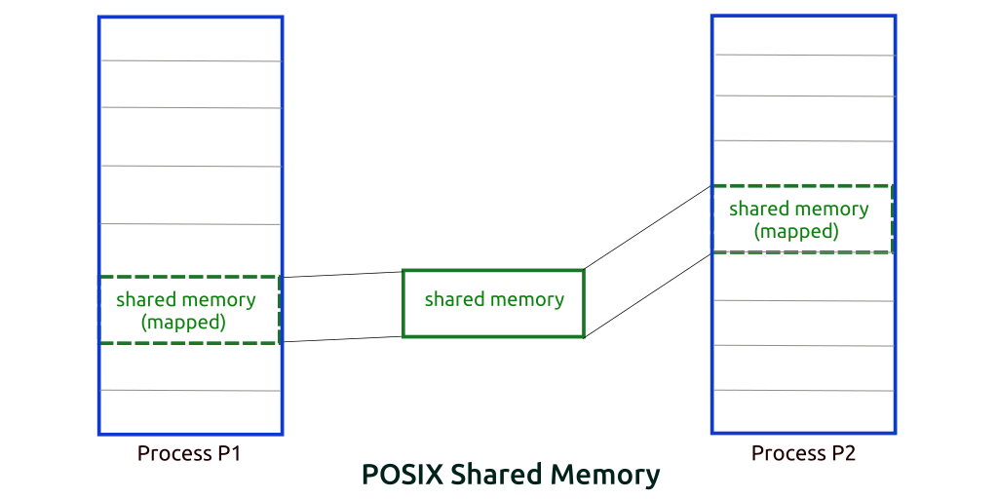
Named vs unnamed semaphores
OS auto-maps semaphore into shared memory for us! (It saves it as a virtual file)
Try:
./semaph
Control-Z after sem value
ipcs; ls /dev/shm
fg; Ctrl-C; ipcs; ls /dev/shm; ipcrm –M…
fg
bring a background job to the foreground.
ipcs
used to provide information about inter-process communication (IPC) facilities
sem

Slide 28
Shared memory usage
You might accidentally have killed your semaphore process before it cleaned up the semaphore
Check ipcs to see your shared memory usage
Use ipcrm -M <key> to delete that memory area
Notes:
https://stackoverflow.com/questions/21129845/why-does-sem-open-work-with-fork-without-shared-memory
https://stackoverflow.com/questions/32205396/share-posix-semaphore-among-multiple-processes

Slide 29
Named Semaphore in Multi-User Environements

Slide 30
Named vs unnamed semaphores
Parent process executes:
sem_t* sem = sem_open("pSem", O_CREAT | O_EXCL, 0644, value);
/dev/shm showed a semaphore called sem.pSem
What if another user runs ./semaph now?
The advantage of unnamed semaphores?
Notes:
https://stackoverflow.com/questions/21129845/why-does-sem-open-work-with-fork-without-shared-memory
https://stackoverflow.com/questions/32205396/share-posix-semaphore-among-multiple-processes

Slide 31
Named vs unnamed semaphores
Parent process executes:
sem_t* sem = sem_open("pSem", O_CREAT | O_EXCL, 0644, value);
/dev/shm showed a semaphore called sem.pSem
What if another user runs ./semaph now?
Notes:
https://stackoverflow.com/questions/21129845/why-does-sem-open-work-with-fork-without-shared-memory
https://stackoverflow.com/questions/32205396/share-posix-semaphore-among-multiple-processes

Slide 32
unnamed semaphores
……
// Allocate shared memory for the semaphore
shmid = shmget(shmkey, sizeof(struct shm_data), 0644 | IPC_CREAT;
…
// Attach the shared memory segment to the parent process
p = (struct shm_data *)shmat(shmid, NULL, 0);
…
// Initialize the semaphore in shared memory, with an initial value of 1
if (sem_init(&p->sem, 1, 1) == -1) {
perror("sem_init"); exit(EXIT_FAILURE);
}
The advantage of unnamed semaphores?

Slide 33
Binary Semaphores vs pthread mutexes

Slide 34
Binary semaphores vs pthread mutexes
What is the difference?

Slide 35
Binary semaphores vs pthread mutexes
What is the difference?
Semaphores can do this:
Thread 1
Thread 2
sem = 1
sem_wait(sem)
sem = 0
sem_post(sem)
sem = 1

Slide 36
Binary semaphores vs pthread mutexes
What is the difference?
pthread mutexes cannot do this
Thread 1
Thread 2
lock = unlocked
_lock(lock)
lock = locked
_unlock(lock)
UNDEFINED BEHAVIOR

Slide 37
Binary semaphores vs pthread mutexes
What is the difference?
Any thread can wait/post on a semaphore
Only the thread that locked a pthread mutex can unlock it

Slide 38
Lab 1 - Tasks
Connect to lab machines, download code
ex1: processes with fork/wait
ex2: pthreads ordering, counter variable
Semaphore usage
ex3: race condition
ex4: pthread joining
ex5: pthread mutexes
ex6: condition variables (starts to get challenging)
ex7: producer-consumer: pthreads (for submission)
ex8: producer-consumer: processes and semaphores (for submission)
ex9: Explanation of observations of ex7 & ex8 (for submission)

Slide 39
Lab 1 - Tasks
Connect to lab machines, download code
ex1: processes with fork/wait
ex2: pthreads ordering, counter variable
Semaphore usage
ex3: race condition
ex4: pthread joining
ex5: pthread mutexes
ex6: condition variables (starts to get challenging)
ex7: producer-consumer: pthreads (for submission)
ex8: producer-consumer: processes and semaphores (for submission)
ex9: Explanation of observations of ex7 & ex8 (for submission)

Slide 40
Condition Variables exercies-6-lab1

Slide 41
Why Condition Variables?
Is this code good?
Waiting thread:
while(true) {
pthread_mutex_lock(&mutex);
if (condition is satisfied) {
/* Do something when condition is satisfied */
done = true;
}
pthread_mutex_unlock(&mutex);
if (done) break;
}
Signaling Thread
pthread_mutex_lock(&mutex);
/* change variable value to make condition satisfied */
pthread_mutex_unlock(&mutex);

Slide 42
Condition Variables
Waiting thread:
pthread_mutex_lock(&mutex);
while(condition not satisfied) {
pthread_cond_wait(&cond_var, &mutex);
}
pthread_mutex_unlock(&mutex);
Signaling Thread
pthread_mutex_lock(&mutex)
/* change variable value */
if (condition satisfied) {
pthread_cond_signal(&cond_var);
}
pthread_mutex_unlock(&mutex);
Handles "spurious wakeups"
Releases mutex when waiting on cond_var
At this point, mutex is re-obtained
Tells the waiting thread to wake up, but thread will only wake up once the signaling thread releases mutex as well.

Slide 43
Condition variables: explained
We ask you to use condition variables in ex7 and semaphores in ex8 to do the same thing
So they must implement similar functionality
Why do they both exist?
Notes:
https://w3.cs.jmu.edu/kirkpams/OpenCSF/Books/csf/html/Condvars.html

Slide 44
Condition variables: explained
Why do they both (condvar, semaphore) exist?
Semaphores are too generic (increment/decrement an integer) to map nicely to all problems
Semaphores cannot broadcast messages to all other threads
Notes:
https://w3.cs.jmu.edu/kirkpams/OpenCSF/Books/csf/html/Condvars.html

Slide 45
Condition Variables
Waiting thread:
pthread_mutex_lock(&mutex);
while(condition not satisfied) {
pthread_cond_wait(&cond_var, &mutex);
}
pthread_mutex_unlock(&mutex);
Signaling Thread
pthread_mutex_lock(&mutex)
/* change variable value */
if (condition satisfied) {
pthread_cond_signal(&cond_var);
}
pthread_mutex_unlock(&mutex);
Handles "spurious wakeups"
Releases mutex when waiting on cond_var
At this point, mutex is re-obtained
Tells the waiting thread to wake up, but thread will only wake up once the signaling thread releases mutex as well.

Slide 46
Spurious Wakeups
Why do we not use if statements for checking condition in the waiting thread?
Waiting thread:
pthread_mutex_lock(&mutex);
if (condition not satisfied) {
pthread_cond_wait(&cond_var, &mutex);
}
// do something to maybe make condition invalid
pthread_mutex_unlock(&mutex);
Signaling thread:
pthread_mutex_lock(&mutex)
// do something to make condition satisfied
if (condition satisfied) {
pthread_cond_signal(&cond_var);
}
pthread_mutex_unlock(&mutex);

Slide 47
Spurious Wakeups
Signaling thread:
pthread_mutex_lock(&mutex)
// do something to make condition satisfied
if (condition satisfied) {
pthread_cond_signal(&cond_var);
}
pthread_mutex_unlock(&mutex);
Problem can be observed if we have 2 waiting threads (i.e. consumers)!
😈Evil waiting thread:
pthread_mutex_lock(&mutex);
if (condition not satisfied) {
pthread_cond_wait(&cond_var, &mutex);
}
// do something to make condition invalid
pthread_mutex_unlock(&mutex);
🥹Innocent waiting thread:
pthread_mutex_lock(&mutex);
if (condition not satisfied) {
pthread_cond_wait(&cond_var, &mutex);
}
pthread_mutex_unlock(&mutex);

Slide 48
Spurious Wakeups
Signaling thread:
pthread_mutex_lock(&mutex)
// do something to make condition satisfied
if (condition satisfied) {
pthread_cond_signal(&cond_var);
}
pthread_mutex_unlock(&mutex);
😈Evil waiting thread:
pthread_mutex_lock(&mutex);
if (condition not satisfied) {
pthread_cond_wait(&cond_var, &mutex);
}
// do something to make condition invalid
pthread_mutex_unlock(&mutex);
🥹Innocent waiting thread:
pthread_mutex_lock(&mutex);
if (condition not satisfied) {
pthread_cond_wait(&cond_var, &mutex);
}
pthread_mutex_unlock(&mutex);
1. Innocent thread released mutex and is waiting on cond_var to be signaled.

Slide 49
Spurious Wakeups
Signaling thread:
pthread_mutex_lock(&mutex)
// do something to make condition satisfied
if (condition satisfied) {
pthread_cond_signal(&cond_var);
}
pthread_mutex_unlock(&mutex);
2. Then, the signaling thread signals condition variables, sets condition satisfied, and then released the mutex
😈Evil waiting thread:
pthread_mutex_lock(&mutex);
if (condition not satisfied) {
pthread_cond_wait(&cond_var, &mutex);
}
// do something to make condition invalid
pthread_mutex_unlock(&mutex);
🥹Innocent waiting thread:
pthread_mutex_lock(&mutex);
if (condition not satisfied) {
pthread_cond_wait(&cond_var, &mutex);
}
pthread_mutex_unlock(&mutex);

Slide 50
Spurious Wakeups
Signaling thread:
pthread_mutex_lock(&mutex)
// do something to make condition satisfied
if (condition satisfied) {
pthread_cond_signal(&cond_var);
}
pthread_mutex_unlock(&mutex);
😈Evil waiting thread:
pthread_mutex_lock(&mutex);
if (condition not satisfied) {
pthread_cond_wait(&cond_var, &mutex);
}
// do something to make condition invalid
pthread_mutex_unlock(&mutex);
🥹Innocent waiting thread:
pthread_mutex_lock(&mutex);
if (condition not satisfied) {
pthread_cond_wait(&cond_var, &mutex);
}
pthread_mutex_unlock(&mutex);
3. Evil thread locks the mutex, because OS may context switch to it instead of the innocent waiting thread.

Slide 51
Spurious Wakeups
Signaling thread:
pthread_mutex_lock(&mutex)
// do something to make condition satisfied
if (condition satisfied) {
pthread_cond_signal(&cond_var);
}
pthread_mutex_unlock(&mutex);
😈Evil waiting thread:
pthread_mutex_lock(&mutex);
if (condition not satisfied) {
pthread_cond_wait(&cond_var, &mutex);
}
// do something to make condition invalid
pthread_mutex_unlock(&mutex);
🥹Innocent waiting thread:
pthread_mutex_lock(&mutex);
if (condition not satisfied) {
pthread_cond_wait(&cond_var, &mutex);
}
pthread_mutex_unlock(&mutex);
4. Condition is satisfied due to signaling thread's activities earlier on, so the if-statement is skipped.

Slide 52
Spurious Wakeups
Signaling thread:
pthread_mutex_lock(&mutex)
// do something to make condition satisfied
if (condition satisfied) {
pthread_cond_signal(&cond_var);
}
pthread_mutex_unlock(&mutex);
😈Evil waiting thread:
pthread_mutex_lock(&mutex);
if (condition not satisfied) {
pthread_cond_wait(&cond_var, &mutex);
}
// do something to make condition invalid
pthread_mutex_unlock(&mutex);
🥹Innocent waiting thread:
pthread_mutex_lock(&mutex);
if (condition not satisfied) {
pthread_cond_wait(&cond_var, &mutex);
}
pthread_mutex_unlock(&mutex);
5. Evil thread does something to make condition invalid again (e.g. dequeue task from queue, making the queue empty again).

Slide 53
Spurious Wakeups
Signaling thread:
pthread_mutex_lock(&mutex)
// do something to make condition satisfied
if (condition satisfied) {
pthread_cond_signal(&cond_var);
}
pthread_mutex_unlock(&mutex);
😈Evil waiting thread:
pthread_mutex_lock(&mutex);
if (condition not satisfied) {
pthread_cond_wait(&cond_var, &mutex);
}
// do something to make condition invalid
pthread_mutex_unlock(&mutex);
🥹Innocent waiting thread:
pthread_mutex_lock(&mutex);
if (condition not satisfied) {
pthread_cond_wait(&cond_var, &mutex);
}
pthread_mutex_unlock(&mutex);
Note that the signal for cond_var is still not consumed!
6. Evil thread finally unlocks mutex.

Slide 54
Spurious Wakeups
Signaling thread:
pthread_mutex_lock(&mutex)
// do something to make condition satisfied
if (condition satisfied) {
pthread_cond_signal(&cond_var);
}
pthread_mutex_unlock(&mutex);
😈Evil waiting thread:
pthread_mutex_lock(&mutex);
if (condition not satisfied) {
pthread_cond_wait(&cond_var, &mutex);
}
// do something to make condition invalid
pthread_mutex_unlock(&mutex);
🥹Innocent waiting thread:
pthread_mutex_lock(&mutex);
if (condition not satisfied) {
pthread_cond_wait(&cond_var, &mutex);
}
pthread_mutex_unlock(&mutex);
7. OS finally context-switches back to the innocent thread.
Innocent thread sees that cond_var was signaled & mutex is unlocked, so it exits the if-statement…

Slide 55
Spurious Wakeups
Signaling thread:
pthread_mutex_lock(&mutex)
// do something to make condition satisfied
if (condition satisfied) {
pthread_cond_signal(&cond_var);
}
pthread_mutex_unlock(&mutex);
😈Evil waiting thread:
pthread_mutex_lock(&mutex);
if (condition not satisfied) {
pthread_cond_wait(&cond_var, &mutex);
}
// do something to make condition invalid
pthread_mutex_unlock(&mutex);
🥹Innocent waiting thread:
pthread_mutex_lock(&mutex);
if (condition not satisfied) {
pthread_cond_wait(&cond_var, &mutex);
}
// do something assuming condition is satisfied
pthread_mutex_unlock(&mutex);
8. Leading to possibly a race condition or undefined behaviour!

Slide 56
Lab 1 - Tasks
Connect to lab machines, download code
ex1: processes with fork/wait
ex2: pthreads ordering, counter variable
Semaphore usage
ex3: race condition
ex4: pthread joining
ex5: pthread mutexes
ex6: condition variables (starts to get challenging)
ex7: producer-consumer: pthreads (for submission)
ex8: producer-consumer: processes and semaphores (for submission)
ex9: Explanation of observations of ex7 & ex8 (for submission)

Slide 57
Summary
Connecting to lab machines
Processes and threads
Mutexes/Semaphores/Condition Variables
Bringing it all together

Slide 58
Questions and Slides Sharing
All these will be shown again at the end~
Slides
Github and Google Drive after every session.
https://github.com/lchangxii/cs3210
You can find the Link in the README if preferring Google Drive

Slide 59
See you next week!
Email: changxi_liu@u.nus.edu

